Slide 1
VS-Quant: Per-vector Scaled Quantization for Accurate Low-Precision Neural Network Inference
FAST: DNN Training Under Variable Precision Block Floating Point with Stochastic Rounding
Be Like Water: Adaptive Floating Point for Machine Learning
Pushing the Limits of Narrow Precision Inferencing at Cloud Scale with Microsoft Floating Point
With Shared Microexponents, A Little Shifting Goes a Long Way
汇报人：鞠 鑫
时 间：23-12-23

Slide 2
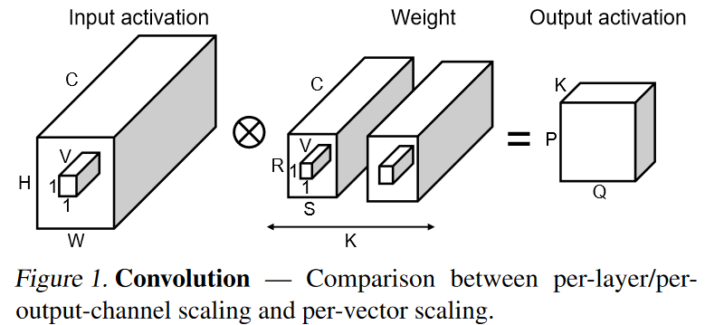
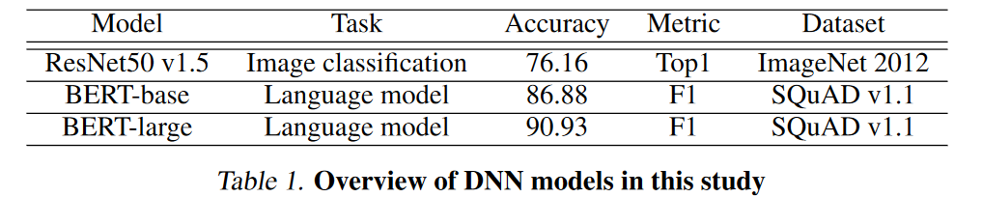
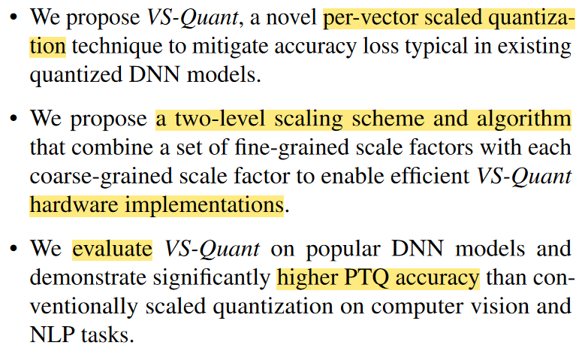
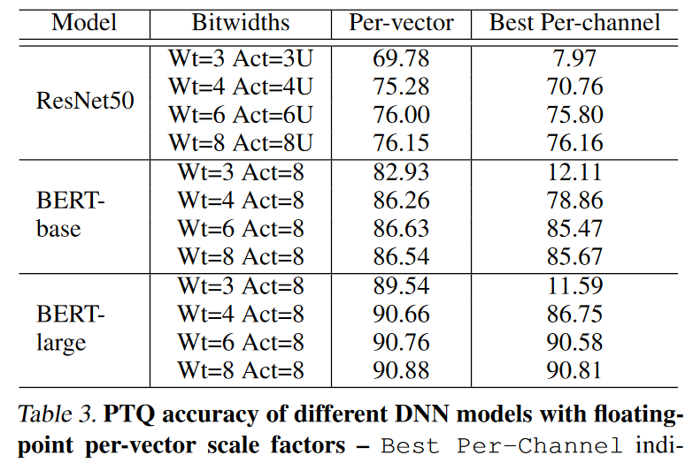
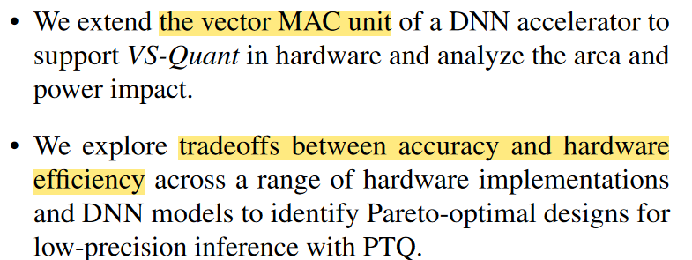
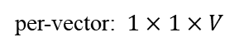
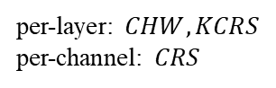
VS-Quant: Per-vector Scaled Quantization for Accurate Low-Precision Neural Network Inference
Nvidia
MLSys 21
coarse-grained scaling
fine-grained scaling
per-layer: $CHW, KCRS$
per-channel: $CRS$
per-vector: $1×1×V$

Slide 3
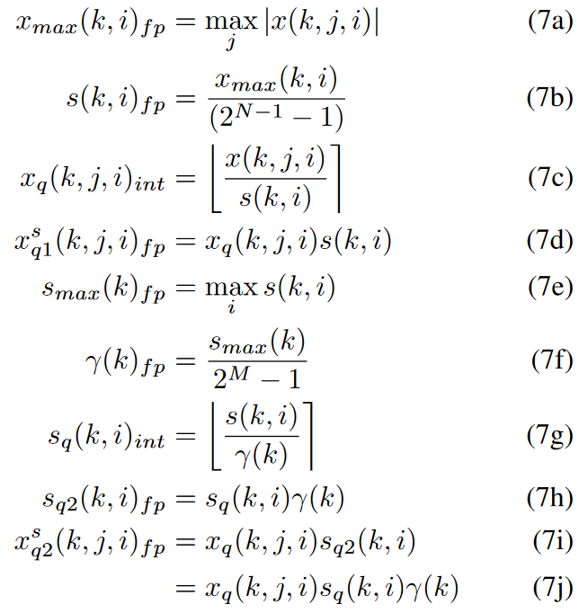
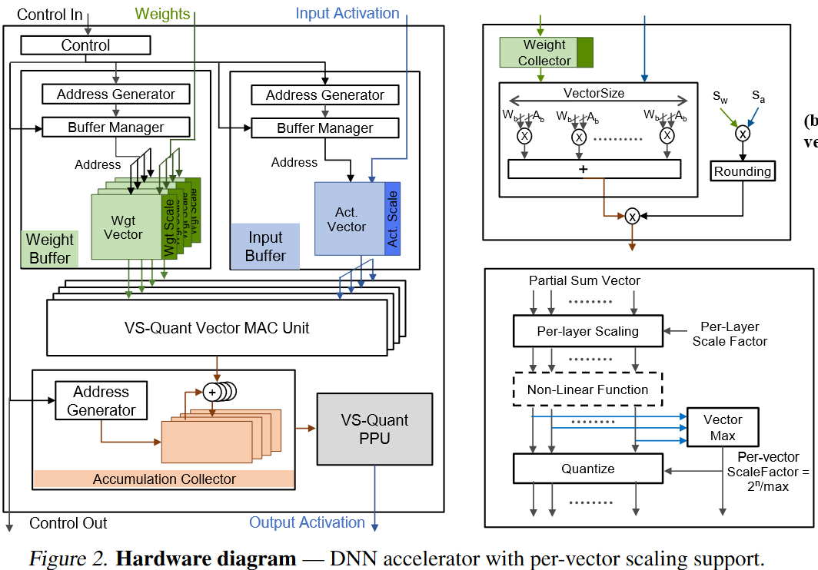
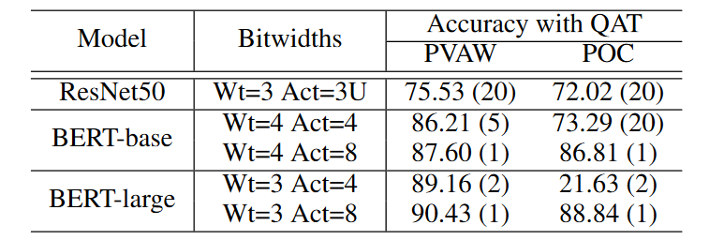
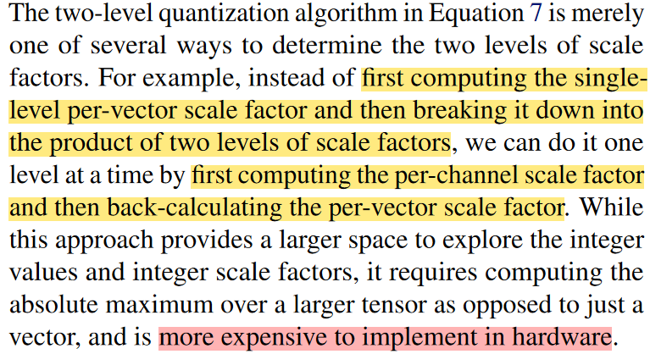
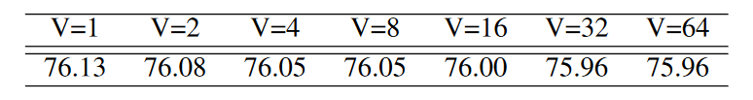
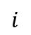
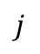
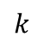
VS-Quant: Per-vector Scaled Quantization for Accurate Low-Precision Neural Network Inference
Nvidia
MLSys 21
QAT study
$$i$$
$$j$$
Accuracy of 6-bit ResNet50 on ImageNet
$$k$$
Notes:
$γ:fp16$, per-channel
$s_{q}:int,$per-vector
accumulation: $2N+\log_{2}V+2M$
Note that only convolution and linear layers have been quantized. Other layers remain in floating-point

Slide 4
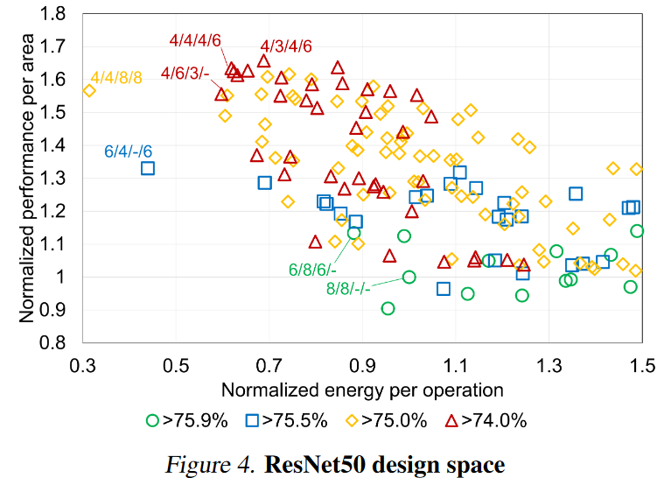
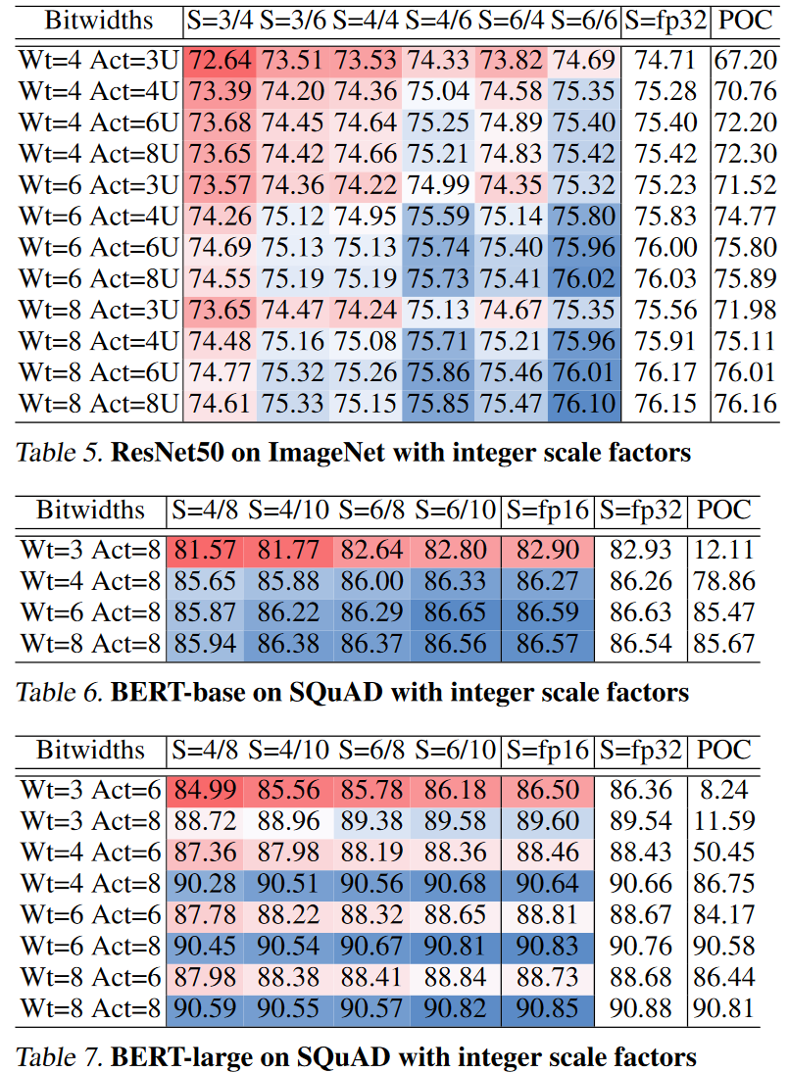
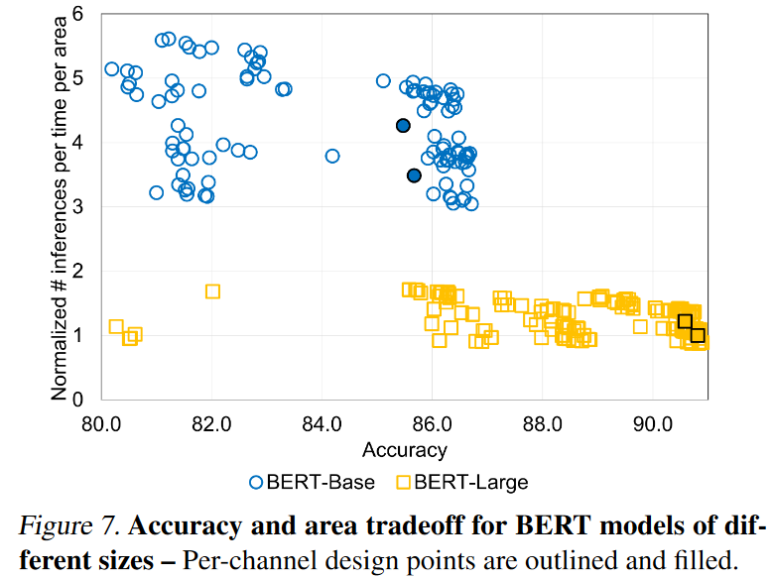
VS-Quant: Per-vector Scaled Quantization for Accurate Low-Precision Neural Network Inference
Nvidia
MLSys 21
Notes:
W/A/ws/as
table: S=fp16, fp32, per-vector

Slide 5
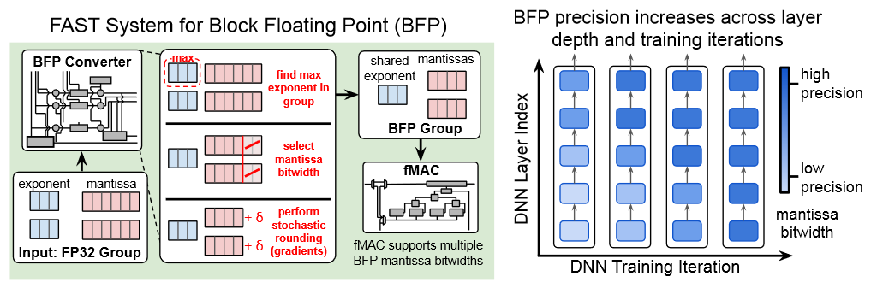
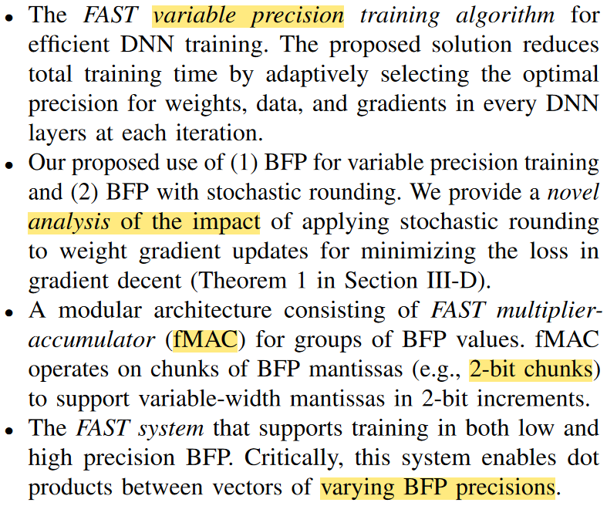
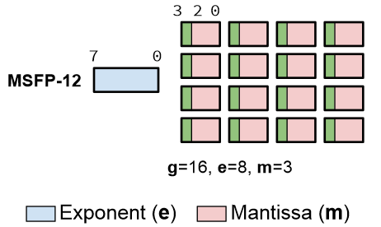
FAST: DNN Training Under Variable Precision Block Floating Point with Stochastic Rounding
Harvard
HPCA 22
Notes:
inference: 3 bits exponent, e=3
mantissa: 2 bits or 4 bits, m=2 or 4
employ stochastic rounding for gradients in conversion from FP to BFP
g=16

Slide 6
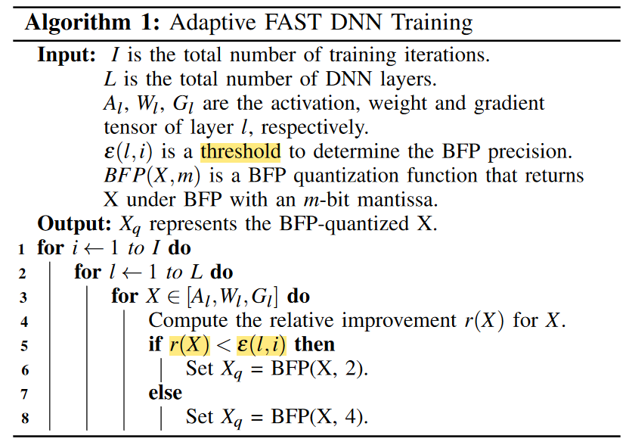
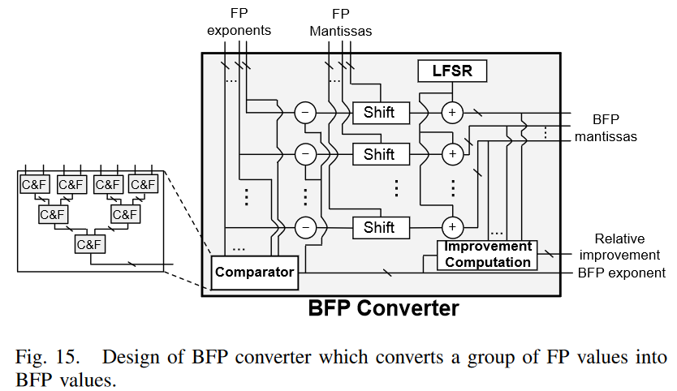
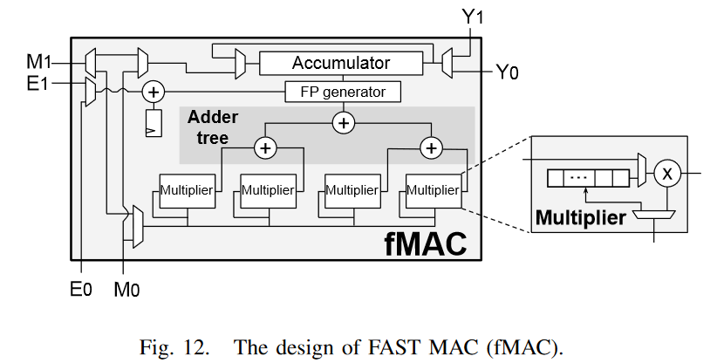
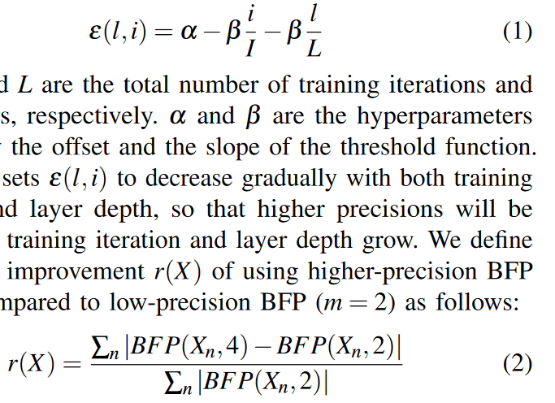
FAST: DNN Training Under Variable Precision Block Floating Point with Stochastic Rounding
Harvard
HPCA 22
Notes:
hyperparameters$: α, β=0.6, 0.3$
comparator: 找最大值
LFSR：随机数生成，8 bits
improvement：algorithm 1

Slide 7
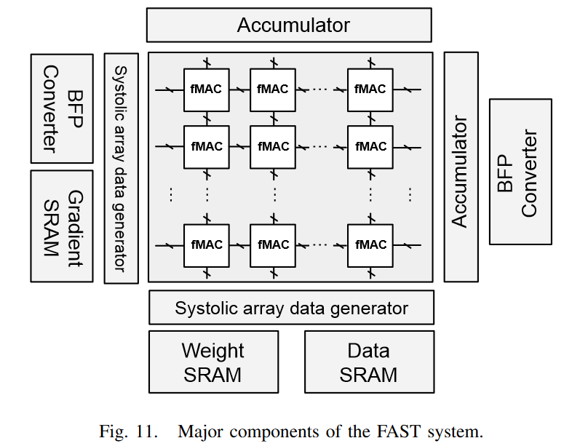
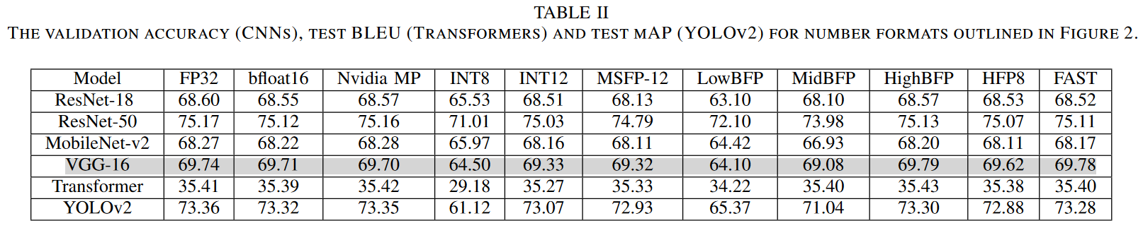
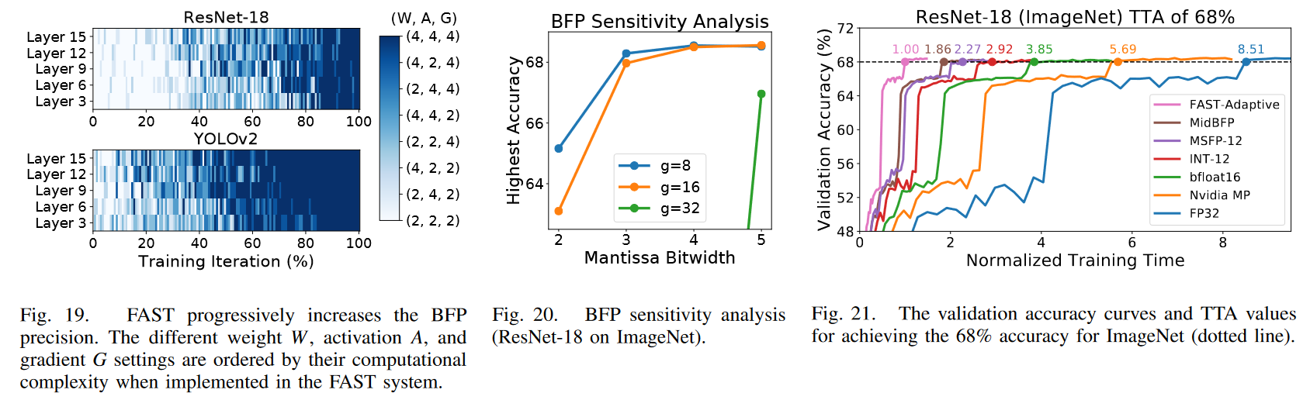
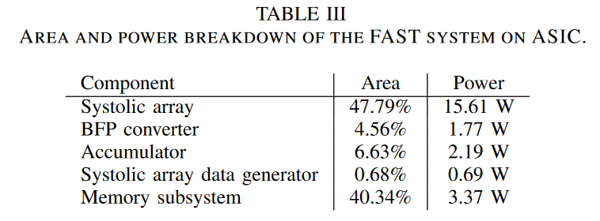
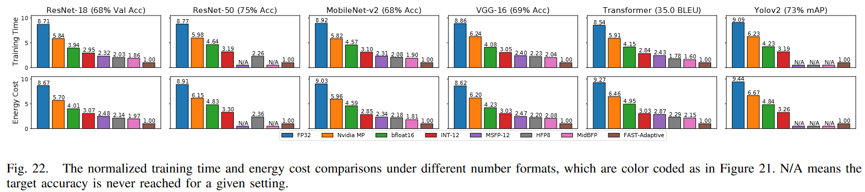
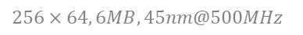
FAST: DNN Training Under Variable Precision Block Floating Point with Stochastic Rounding
Harvard
HPCA 22
$$256×64, 6MB, 45nm@500MHz$$
Notes:
多向SA，支持WS，OS
only implements the convolution and fully connected layers, Additional specialized hardware units are generally used in conjunction with systolic arrays for normalization and activation
LowBFP: e=3, m=2
MidBFP: e=3, m=3
HighBFP: e=3, m=4
TTA: time-to-accuracy, evaluation metric

Slide 8
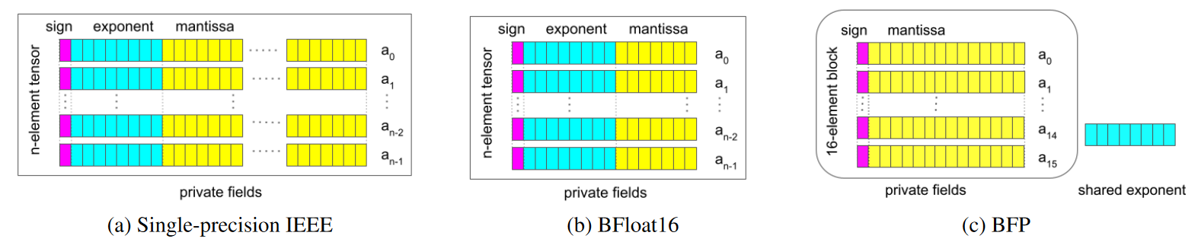
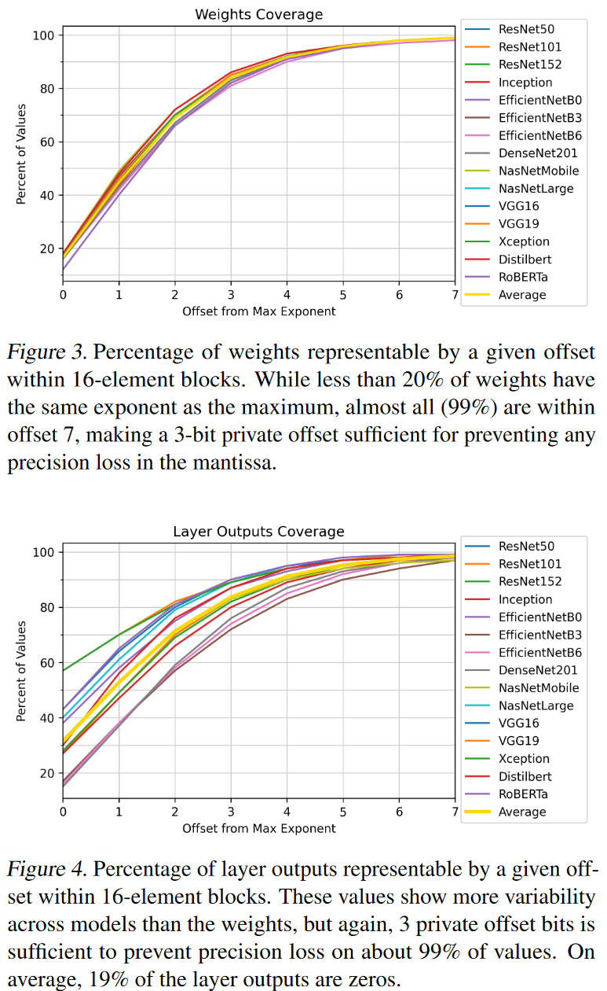
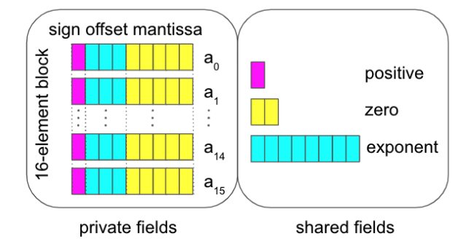
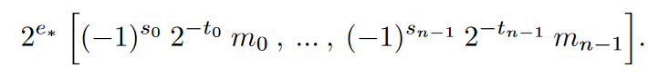
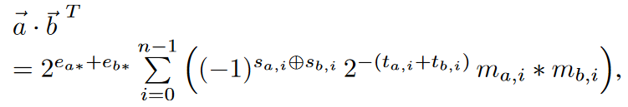
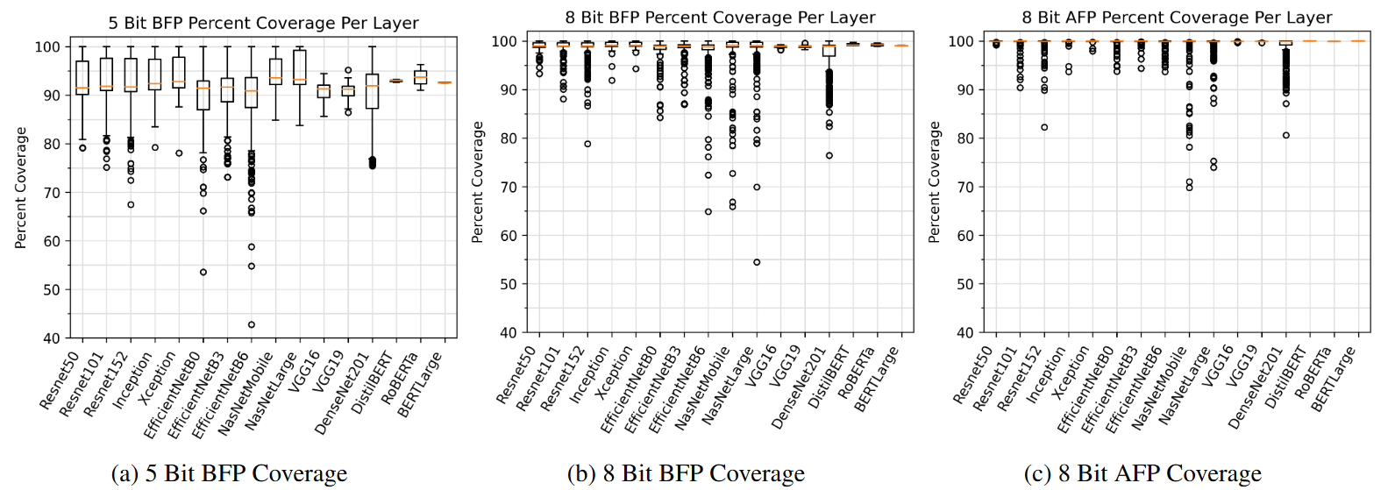
Be Like Water: Adaptive Floating Point for Machine Learning
Pomona
PMLR 22
Notes:
sign: 1 bit offset: 3 bits mantissa: 5 bits exponent: 8 bits positive: 2 bits, 每一位标志8个数据是否都为正数，如果是，则用来表示尾数 zero：4 bits
a maximum offset of 7 still covers 99% of the values on average for 32-element and 64-element blocks. Based on our simulations, the fine grain block size of 16 provides a good balance between model accuracy and hardware optimization. Larger block sizes have minimal impact on memory density but increase hardware complexity and wire delays.
箱线图

Slide 9
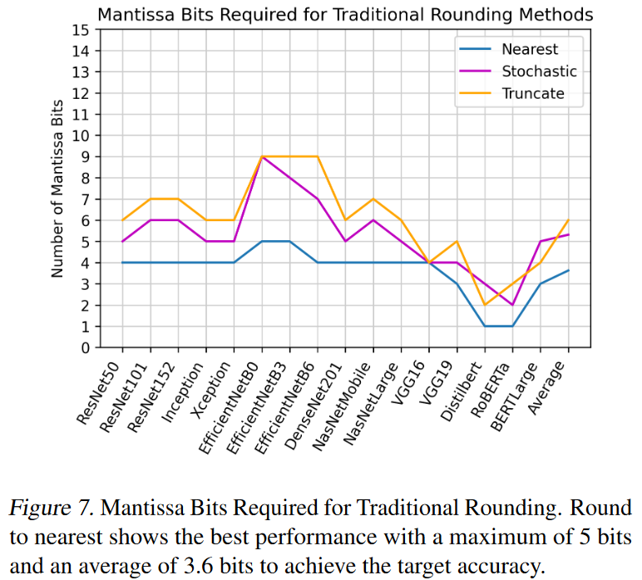
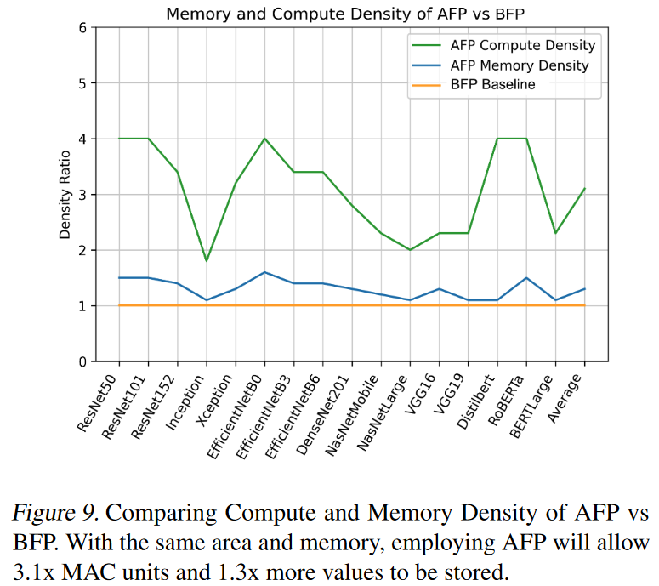
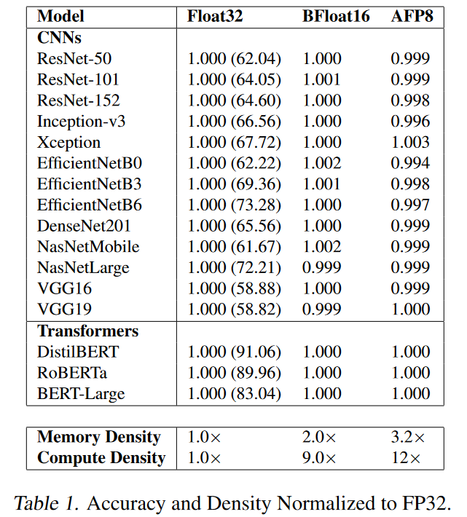
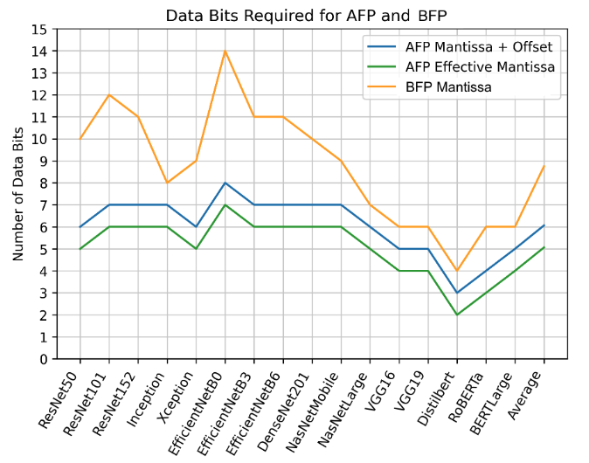
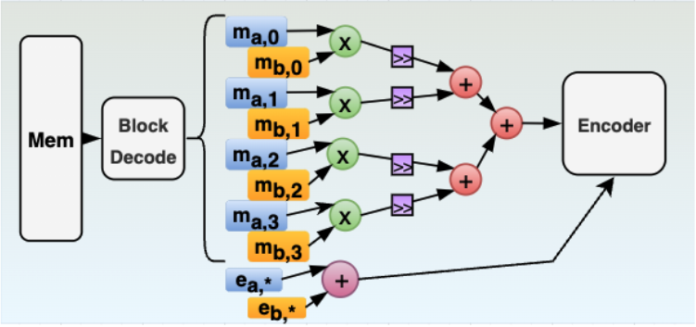
Be Like Water: Adaptive Floating Point for Machine Learning
Pomona
PMLR 22
Notes:
figure7：e=8 bits

Slide 10
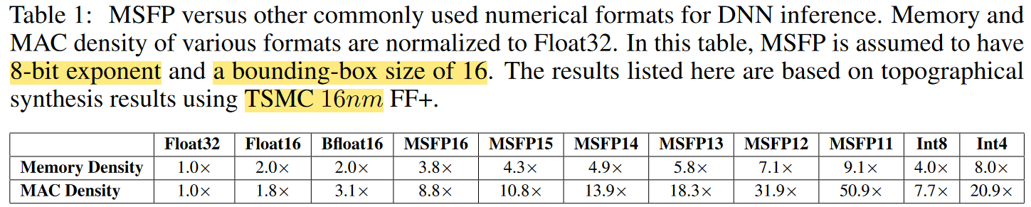
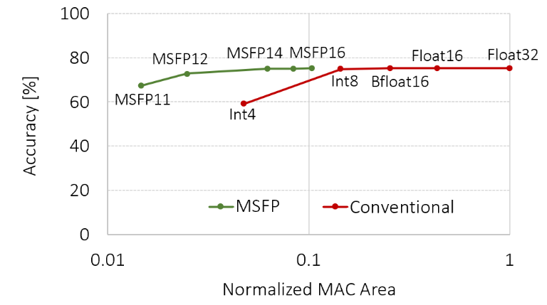
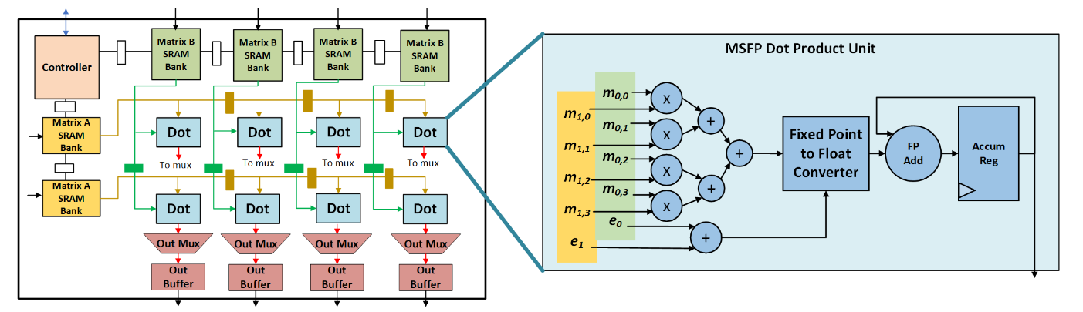
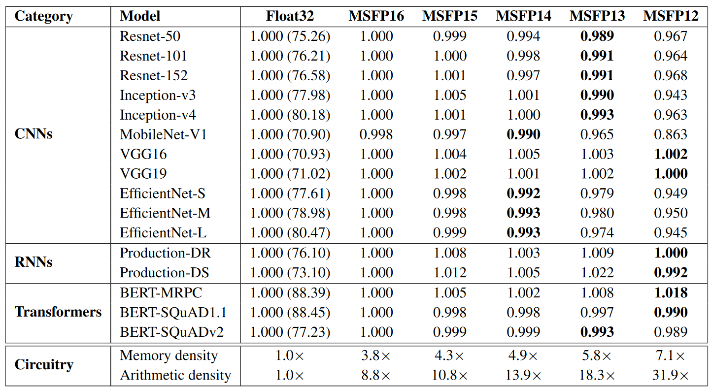
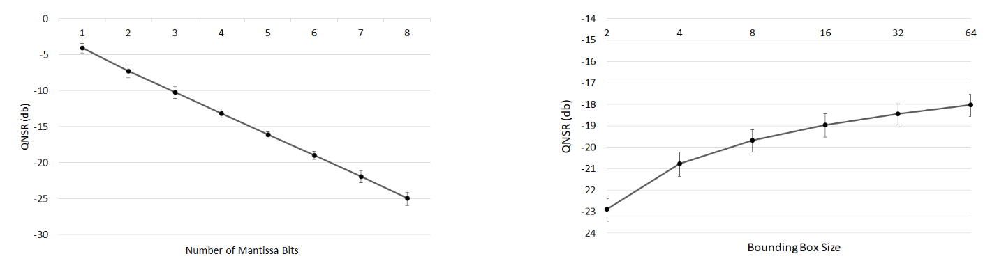
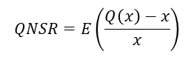
Pushing the Limits of Narrow Precision Inferencing at Cloud Scale with Microsoft Floating Point
Microsoft
NeurIPS 20
MSFP15: 1-8-6
$$QNSR=E\left(\frac{Q\left(x\right)−x}{x}\right)$$
Configurations with the lowest bit-width that stays within 1% of Float32 accuracy are shown in bold
Notes:
没有隐含位
e=8 bits g=16

Slide 11
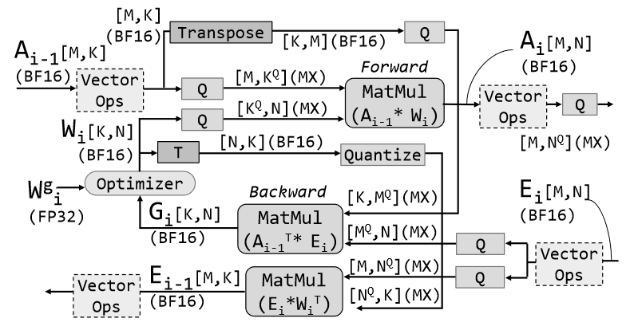
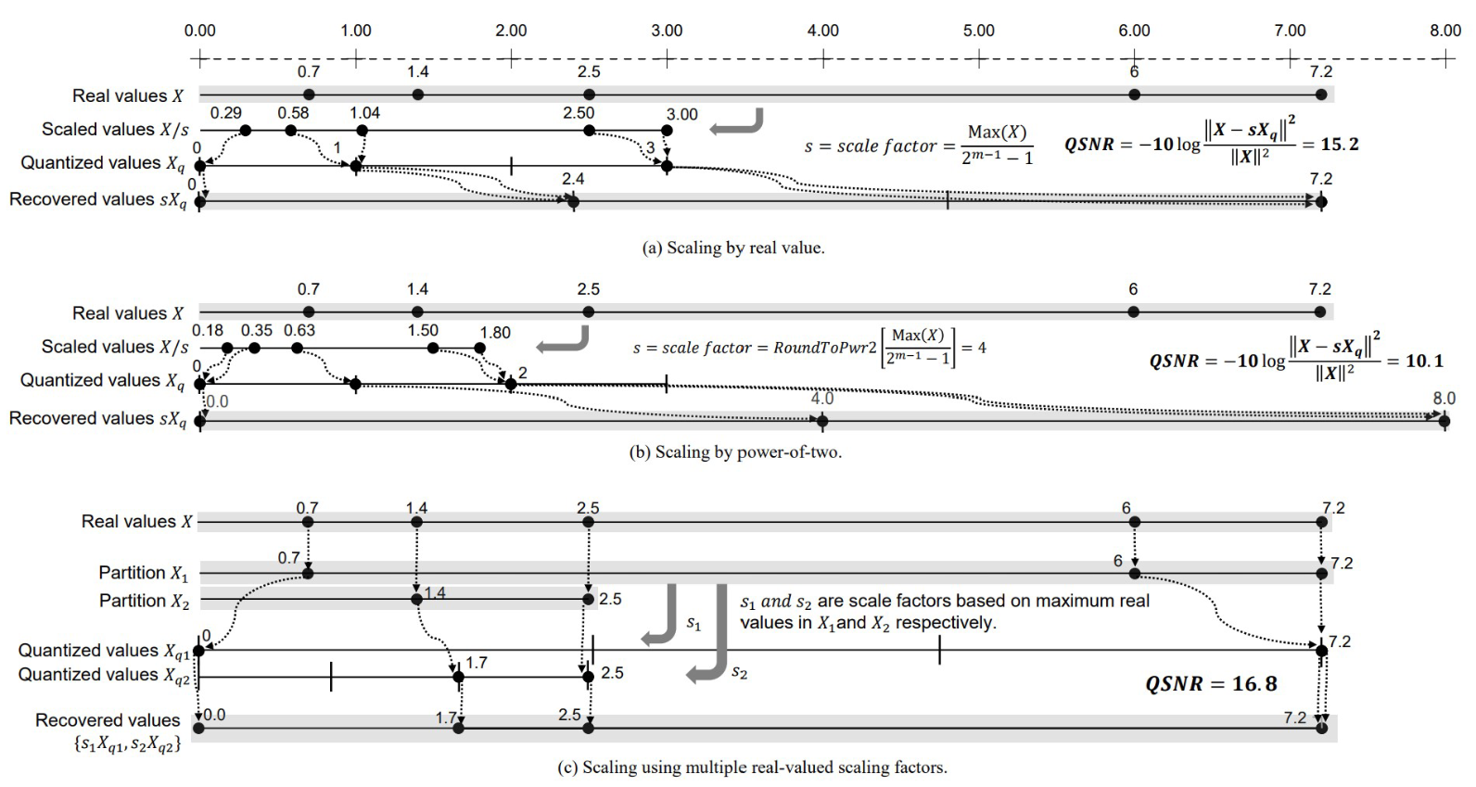



With Shared Microexponents, A Little Shifting Goes a Long Way
Microsoft
ISCA 23

